Slide 1
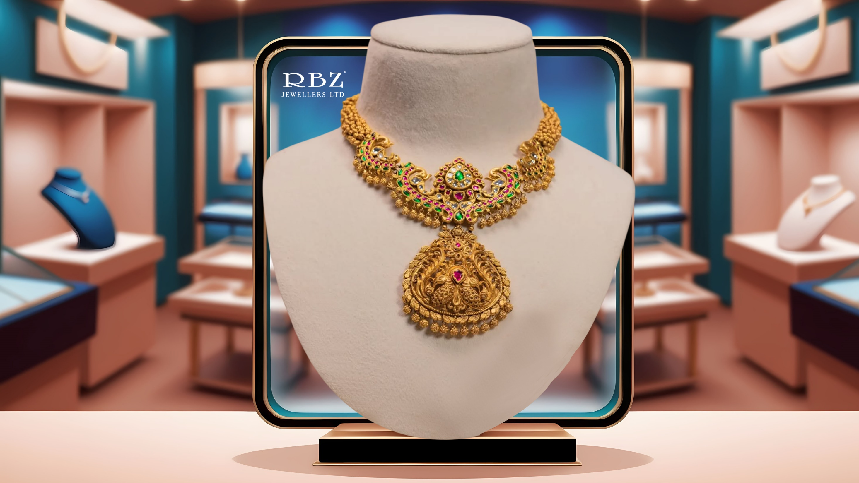

RBZ Jewellers
Limited
Earnings Presentation
Q1FY27

Slide 2



Snapshot
30+ Years
of rich legacy in
Jewellery Industry
Leading
organized manufacturer
Of Gold Jewellery
2+ Tons
annual production capacity
250+
team of artisans and craftsmen
20 States &
72 Cities
across India
190+ Clients
in wholesale business
30% & 35%
3 Year Revenue & PAT CAGR respectively
ROCE: 29%
ROE: 20%

Slide 3
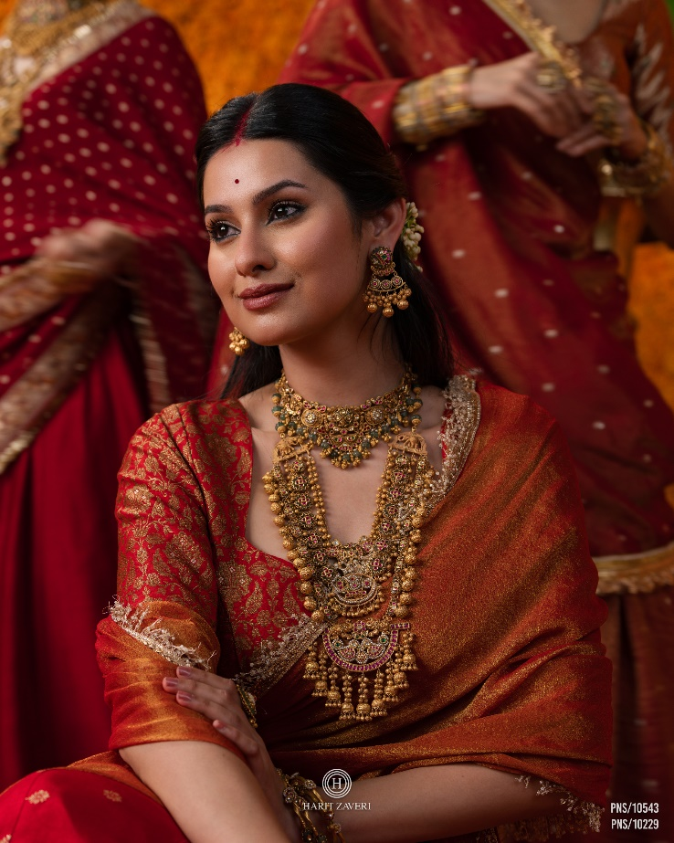
COMPANY OVERVIEW

Slide 4
Company Overview
Founded in 2008, RBZ Jewellers is a leading organised gold jewellery manufacturer led by the father-son duo of Mr. Rajendrakumar and Mr. Harit Zaveri.
Supplies gold jewellery to leading national retailers through wholesale and job-work arrangements, while also serving consumers through its flagship retail store in Ahmedabad.
Operates a 23,966 sq. ft. advanced manufacturing facility equipped with casting, laser, and 3D printing technologies.
Backed by 200+ professionals and 250 skilled artisans, combining traditional craftsmanship with modern innovation.
Offers a diversified jewellery portfolio across multiple manufacturing techniques, with a strong niche in Antique Gold bridal jewellery.
Retail presence through Harit Zaveri Jewellers, offering bridal, occasion, and daily-wear jewellery across gold, silver, studded, and other categories.
RBZ
B2B
B2C
Wholesale
Job work
Retail

Slide 5
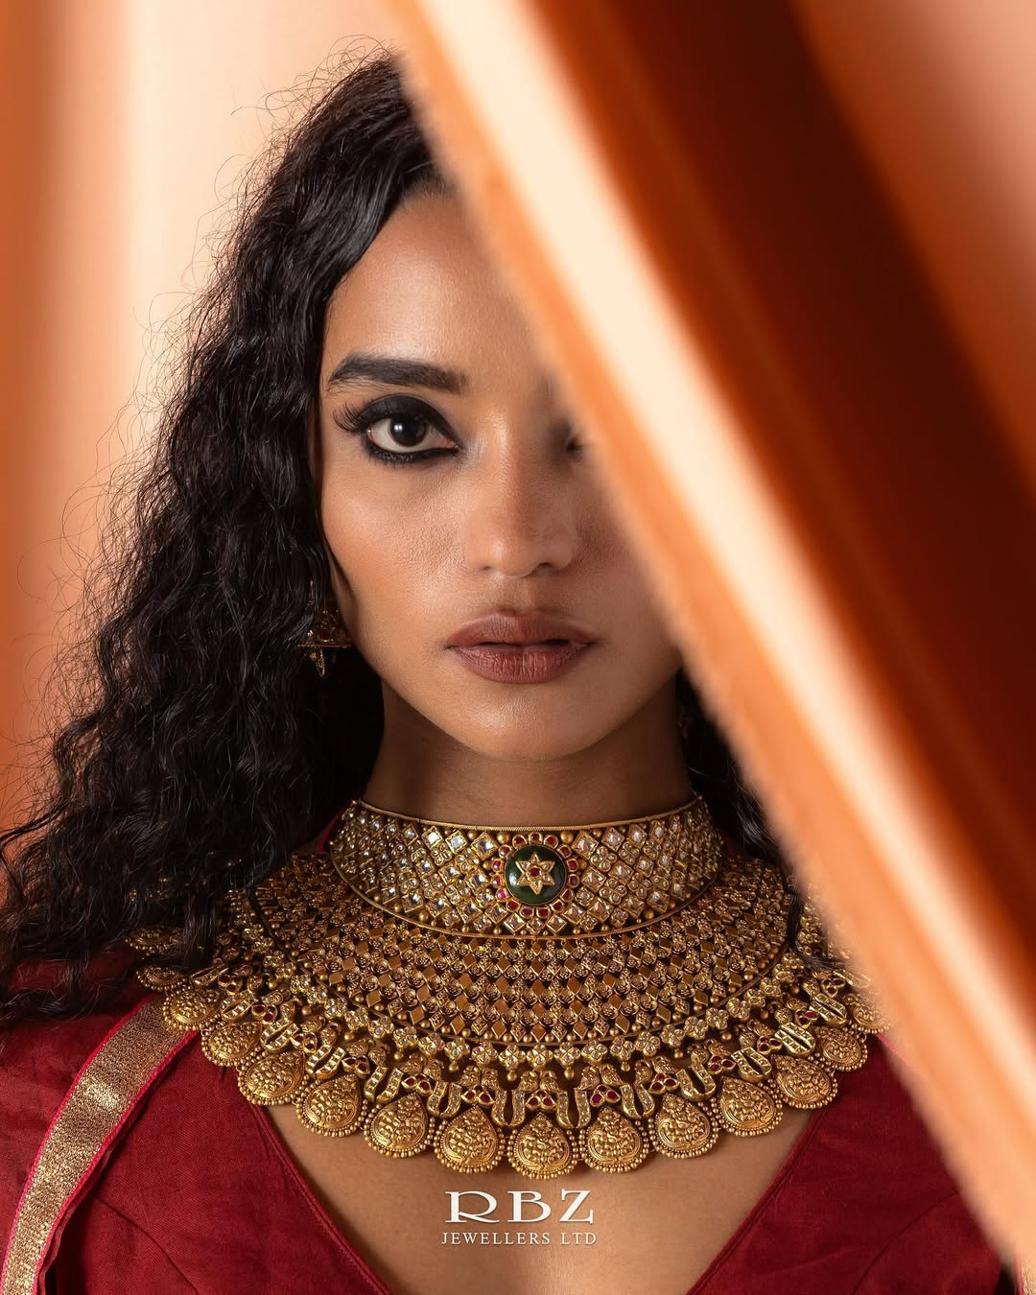

BUSINESS OVERVIEW

Slide 6
Synergies Across the Value Chain
Manufacturing
In-house design, production &
quality control
Faster time-to-market for new trends
Retail
Direct brand connect with end consumers
Strengthens brand positioning through control over end-to-end experience
Wholesale
Drives economies of scale in manufacturing
Deep network with national retailers

Slide 7
Retail Business
The Company currently operates with its flagship retail showroom in Ahmedabad in B2C with Brand Name “Harit Zaveri Jewellers”.
It was built with the aim of bringing transparency and ethical practices in maintaining and offering the finest quality of Jewellery at the right price to customers in the retail market.
The showroom is spread over 11,667 sq. ft. and is situated in Satellite area of Ahmedabad, Gujarat in the vicinity where other large retailers have their presence.
The Retail division offers gold and Polki jewellery along with other jewellery such as platinum, silver, diamond and other artifacts.
Within these product categories, RBZ offers jewellery for various occasions, including festivals, weddings and daily wear.
The range includes a wide variety of jewellery options such as rings, earrings, pendants, bracelets, necklaces, chains, waistbands, and bangles.
The retail business comprises approximately 65% occasion wear and 35% daily wear on average.

Slide 8
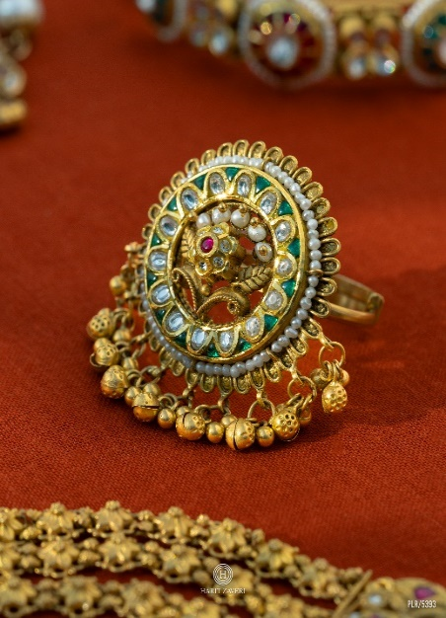
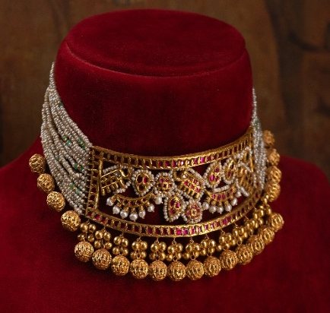
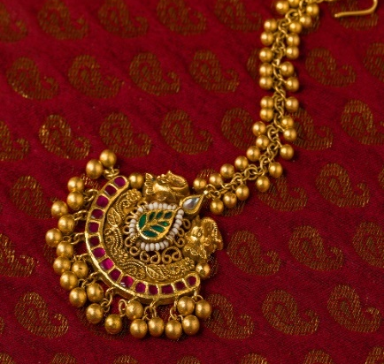
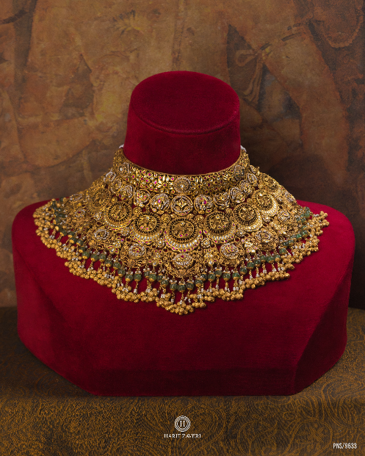
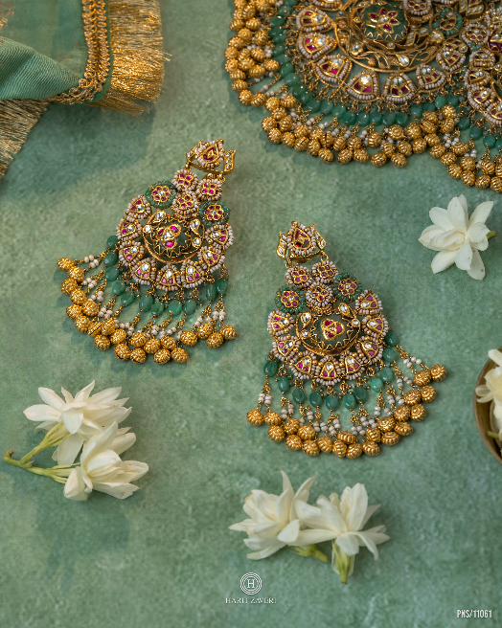
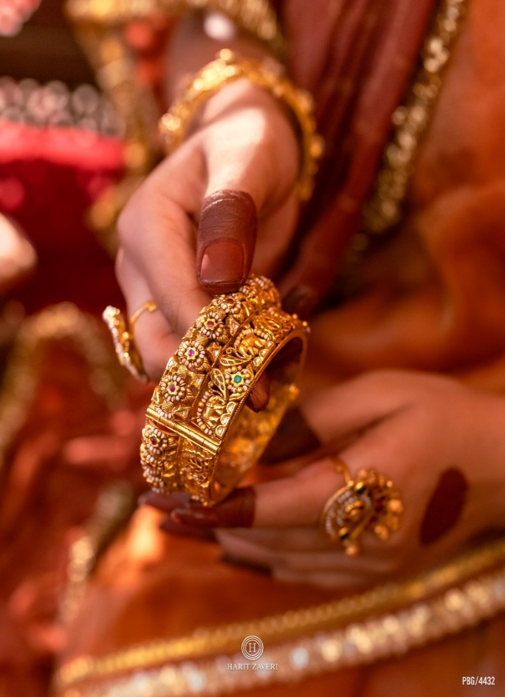
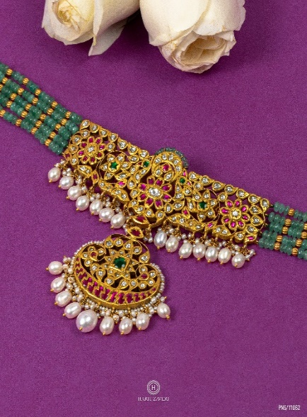
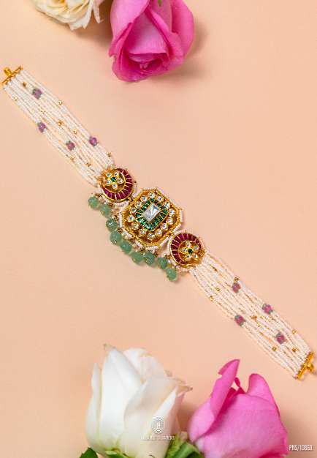
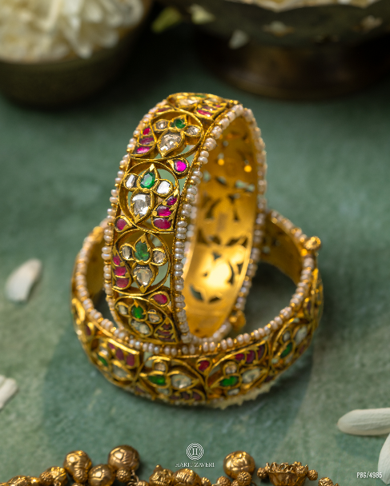
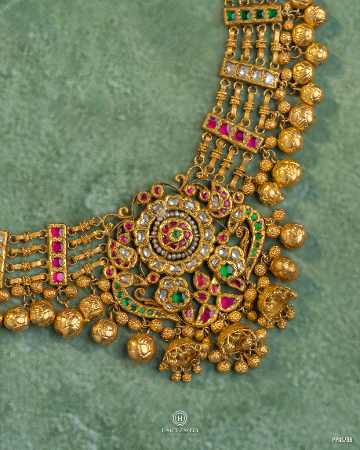
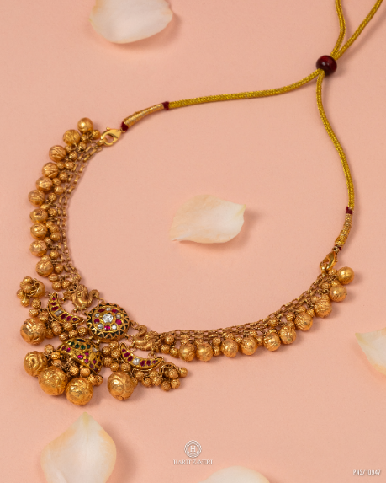
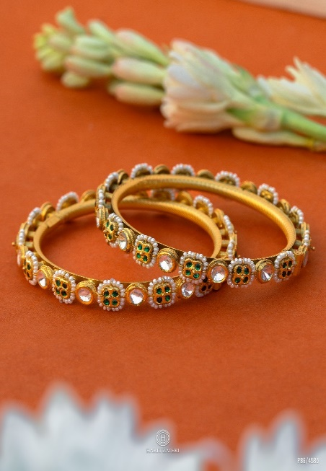
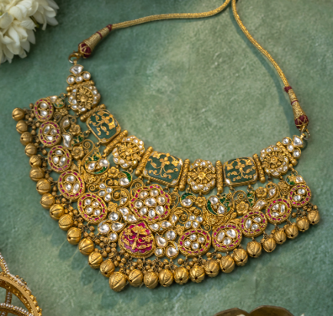
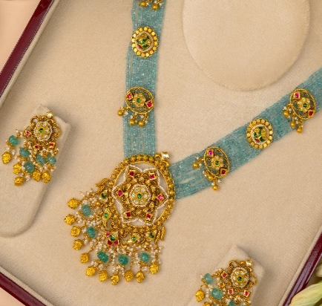
Product Collections

Slide 9
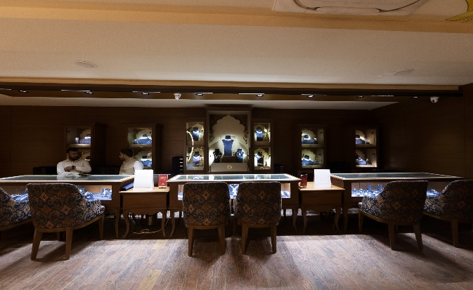
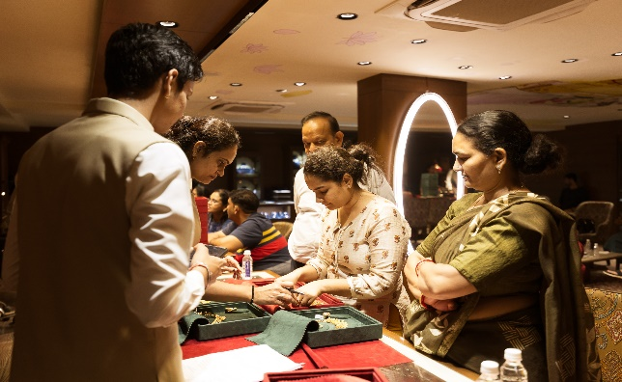
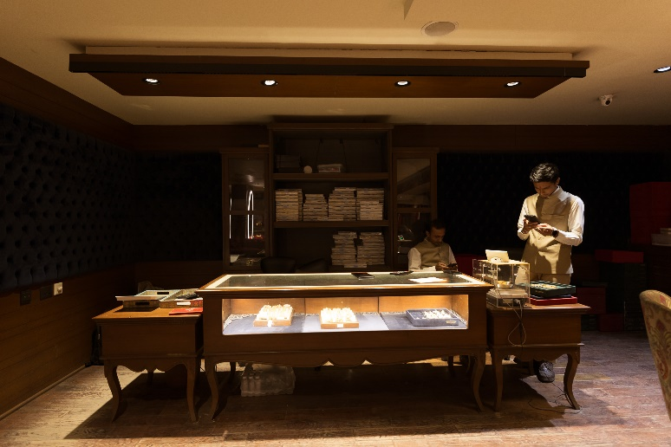
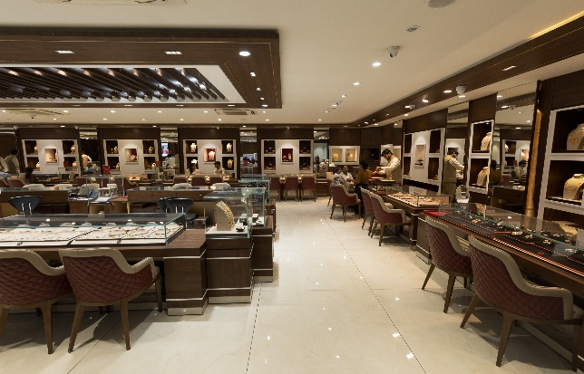
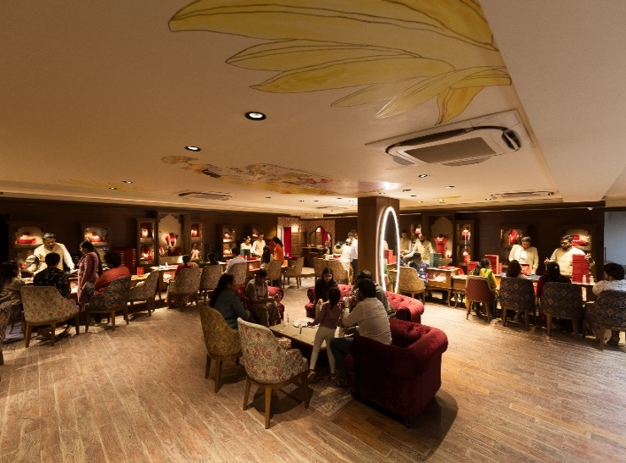
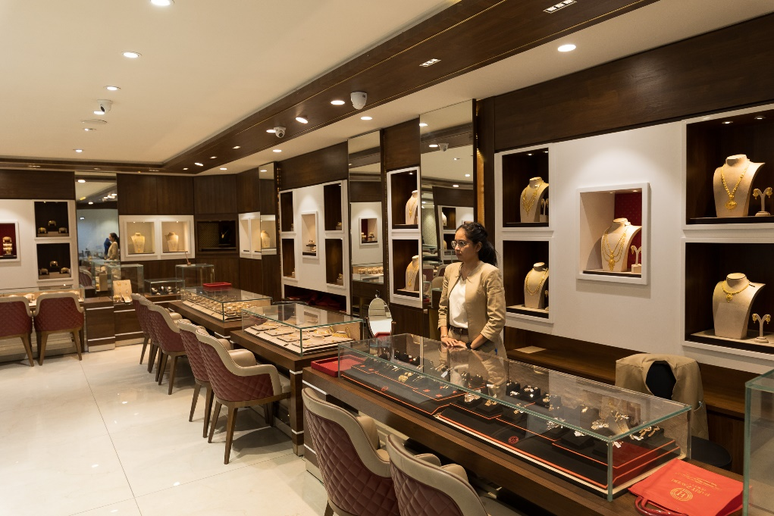
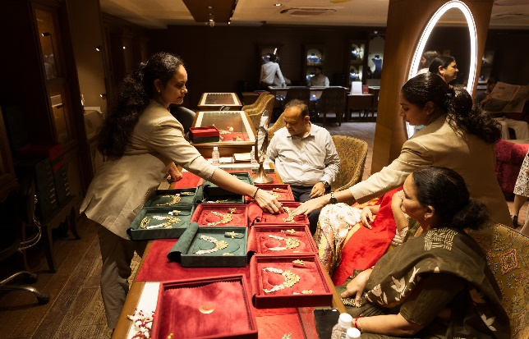
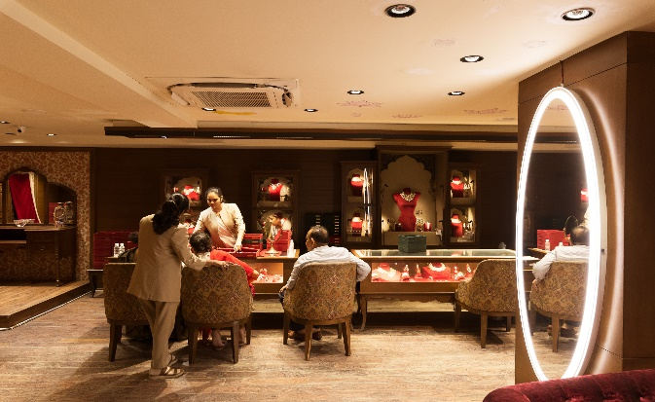
Retail Store – Ahmedabad

Slide 10
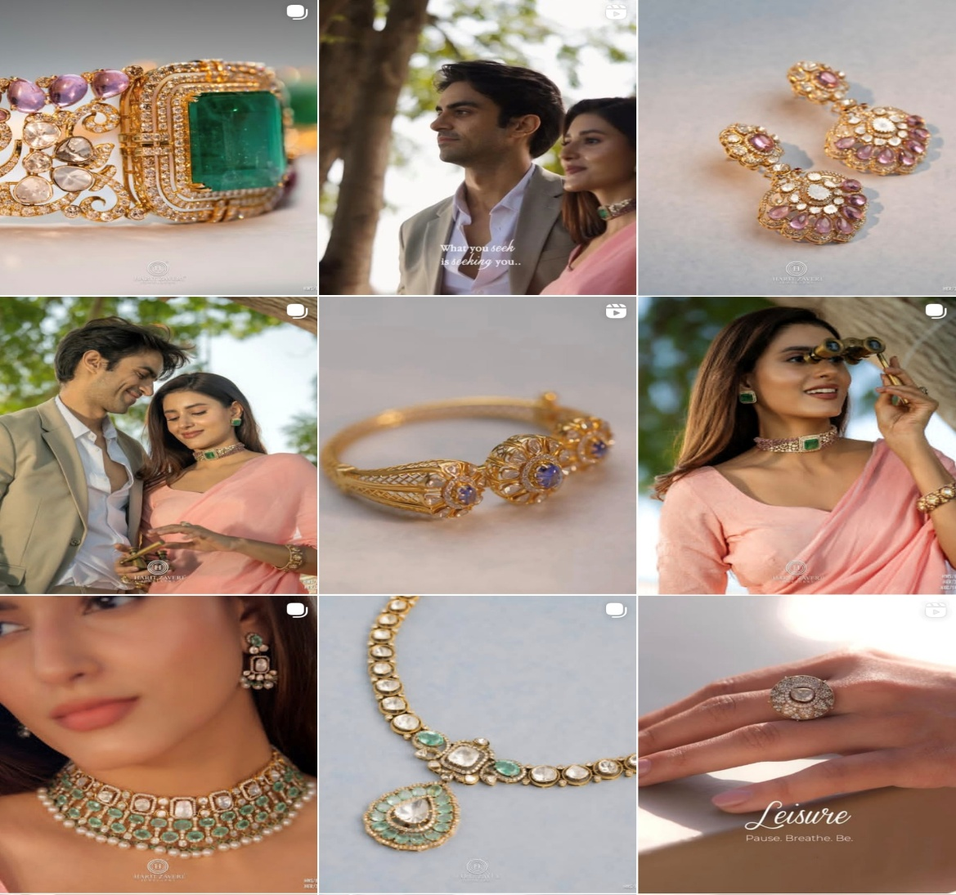
Progress in Digital Marketing Initiatives
Social Media Follower Trend
Digital Media Campaign

Slide 11
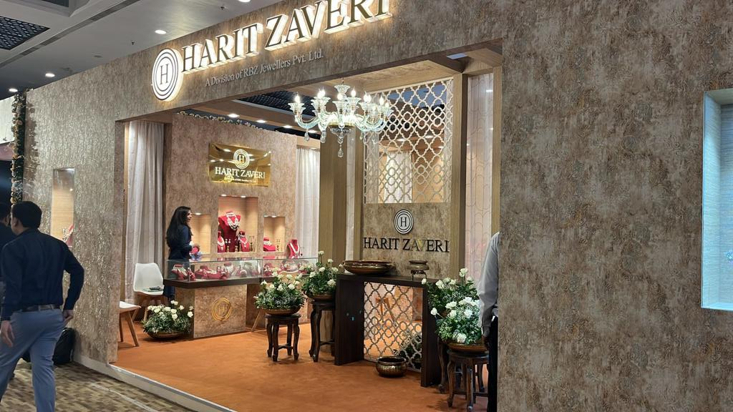
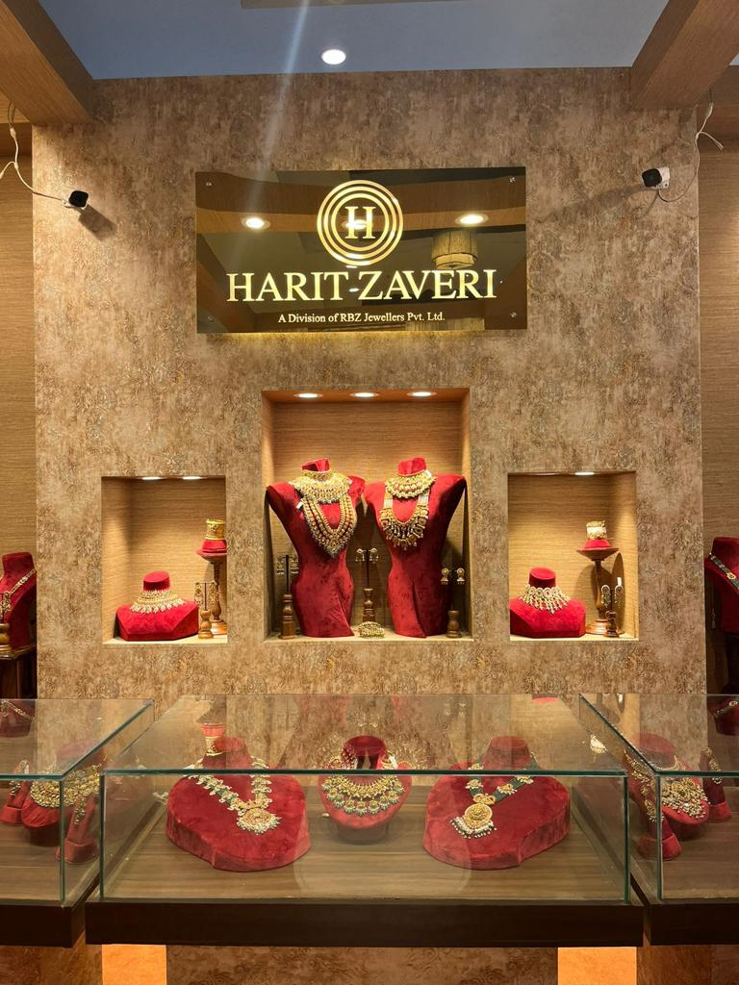
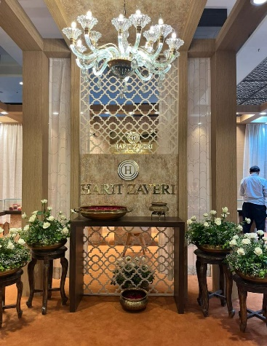
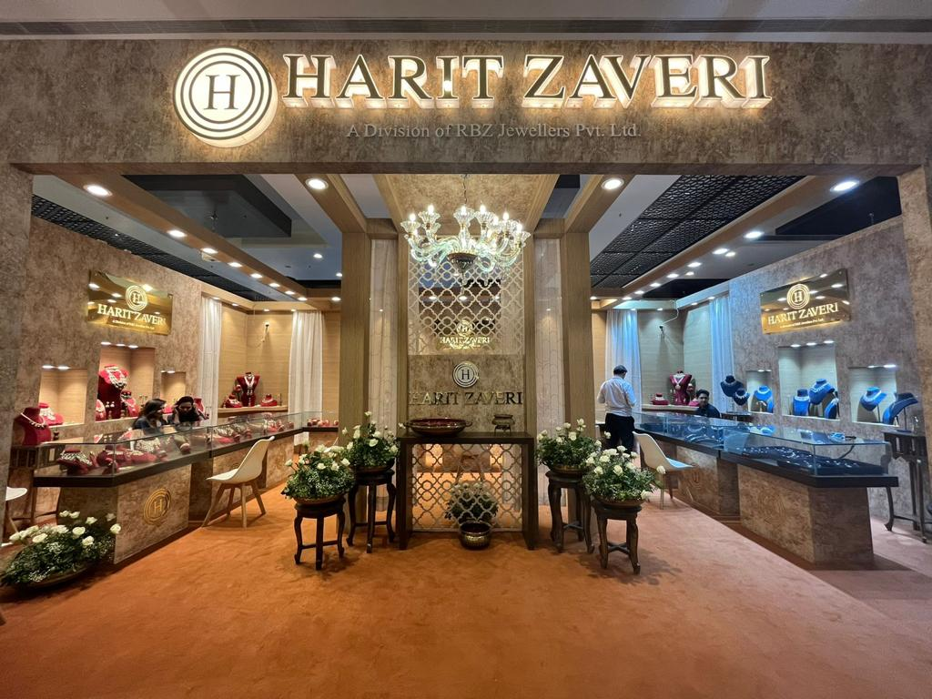
Exhibitions - Retail

Slide 12
Wholesale Business
Supply customized, high-quality gold jewellery to leading national and regional retailers across India.
Presence in 72+ cities across 20 states, serving marquee clients including Titan, Malabar Gold, and Senco Gold.
Strong expertise in Antique Gold bridal jewellery, featuring Jadau, Meena, Kundan, and Polki craftsmanship.
Cater to a network of ~190 retail partners, with a primary focus on the bridal and occasion-wear segments.
In-house manufacturing capabilities ensure scalability, consistent quality, and timely fulfillment of bulk orders.
Provide custom design and private-label solutions, enabling retailers to offer differentiated product portfolios.
Command approximately 1% share of India's organized wholesale gold jewellery market.

Slide 13
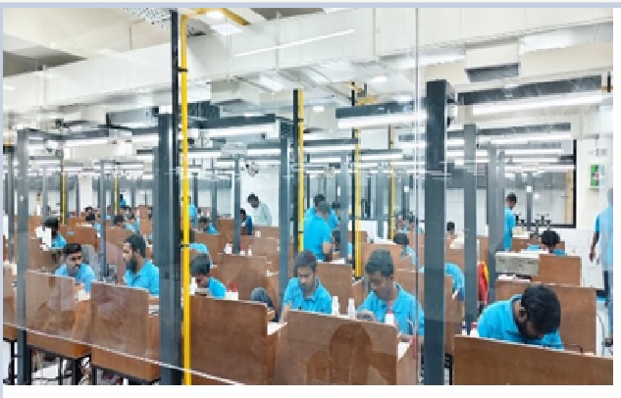
Manufacturing Facility
Located on the
Sarkhej Gandhinagar Highway in Ahmedabad, Gujarat.
Offering flexible design and manufacturing, blending innovation, skilled artisans and select outsourcing to ensure unique, high-quality products.
Spans approximately 23,966 sq.ft and is wholly owned by RBZ Jewellers.
End-to-end in-house manufacturing setup combining advanced machinery with skilled human craftsmanship.
Designed to accommodate up to 250 skilled artisans with 200 employees.
Cutting-edge technologies, including advanced casting, laser and 3D printing equipment to enhance design precision and production efficiency.
Annual production capacity of over 2 tons of high-quality jewellery.
Equipped to handle the entire jewellery manufacturing process under one roof, from design to final finishing.

Slide 14








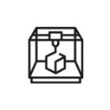




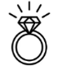



























Manufacturing Process
Design
1
Research
2
Ideate
3
Design
4
Prototype
Market Research
Design Brief
Inspiration
CAD Modeling
CAM Prototyping
Sales Feedback
and Review
Concept Sketching
Element Detailing
Technical Drawing
Trend study
and Forecast
Sales Analysis
Mood Boards
Form Generation
Laser Cut/Engraving Sampling
Die Stamp Element Generation
Manufacturing
Stage 1
Stage 2
Stage 3
Stage 4
Raw Gold Procurement
Investment Casting
Laser Cutting Laser Engraving
Progressive Die Stamping
Hydraulic Die Pressing
Jadai
Enameling
Powai
Pricing
Alloying
Quality Check
Polishing
Soldering
Quality Check
Antique Finish
Assembling
Dispatch
Quality Control
1
Raw Material Testing
2
Design Observation
Production Process Examination Checklist
3
Final Inspection and Packaging
XRF
Concept
Observation
Element Quality Inspection
Basic
Aspects
Aesthetic
Aspects
Functional
Aspects
Purity Testing
Gemstone Testing
Durability Check
Hallmarking
Safety Wrapping, Packing
Gold Purity
No Non-Gold Item
Gemstone Quality
Pearl Quality
Beads Quality
Shape Uniformity
No Damage
No Polish Discoloration
No Excess Solder
Proper Enamel
No Sharp Edges
No Strength Issue
Proper Fit and Fall
Proper Findings
Product as per SOP
Fire Assay

Slide 15
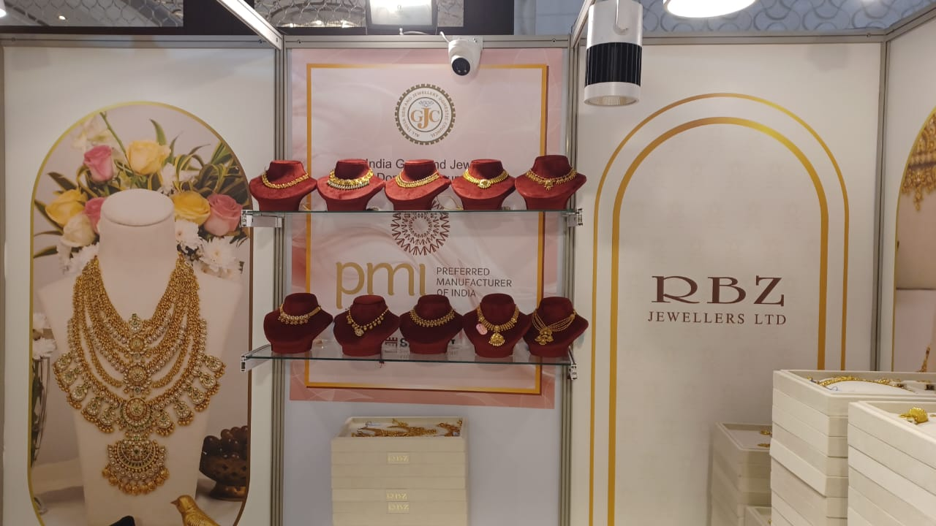
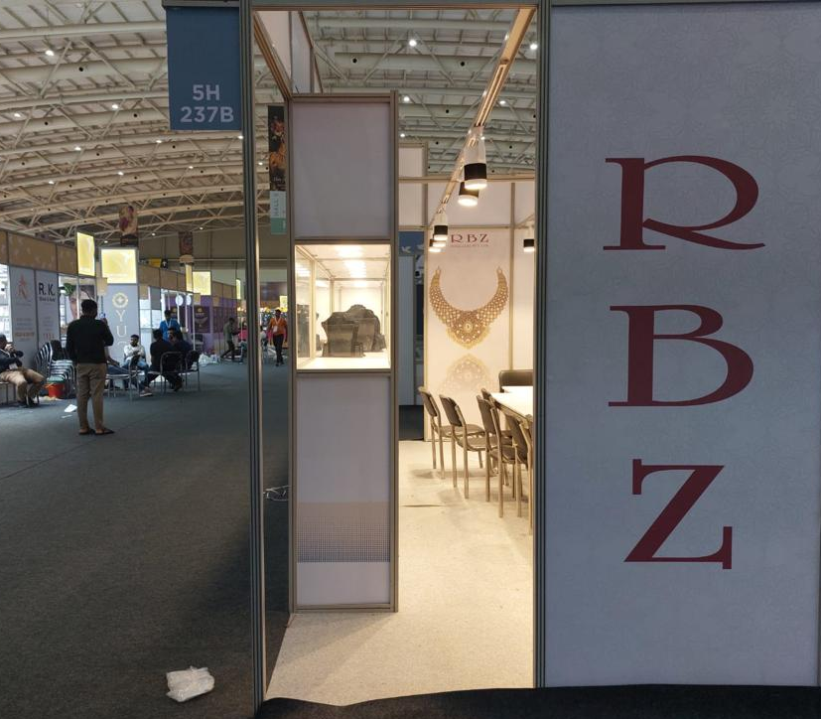
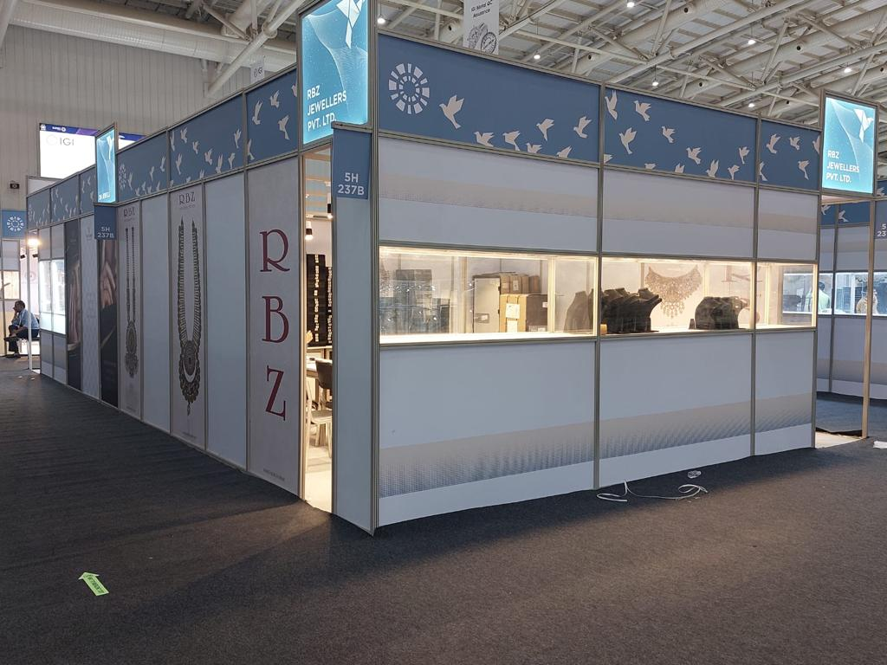
Exhibitions - Wholesale

Slide 16
Job Work Services
Provides design and manufacturing services for leading jewellery retailers, with gold supplied by the customer.
Highest-margin segment, with revenues generated through making charges and limited working capital requirements.
Enables an asset-light business model by minimizing investment in gold inventory while supporting demand fulfillment.
Drives higher capacity utilization, operational efficiency, and margin expansion through optimal use of manufacturing infrastructure.
Strengthens relationships with leading national retailers and supports the company's presence across 72 cities in 20 states.
Accounted for 52% of total gold volumes sold in FY26, highlighting its strategic importance to the business.
Specialized expertise in Antique Gold bridal jewellery, leveraging RBZ's design and manufacturing capabilities.

Slide 17












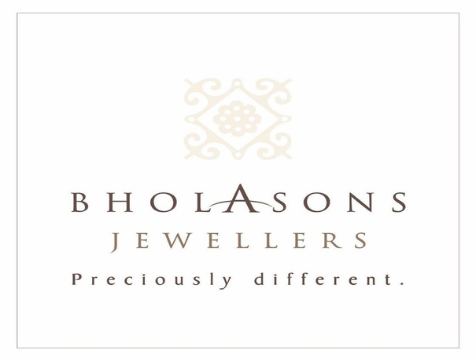
Marquee Clients
Wholesale
Jobwork

Slide 18
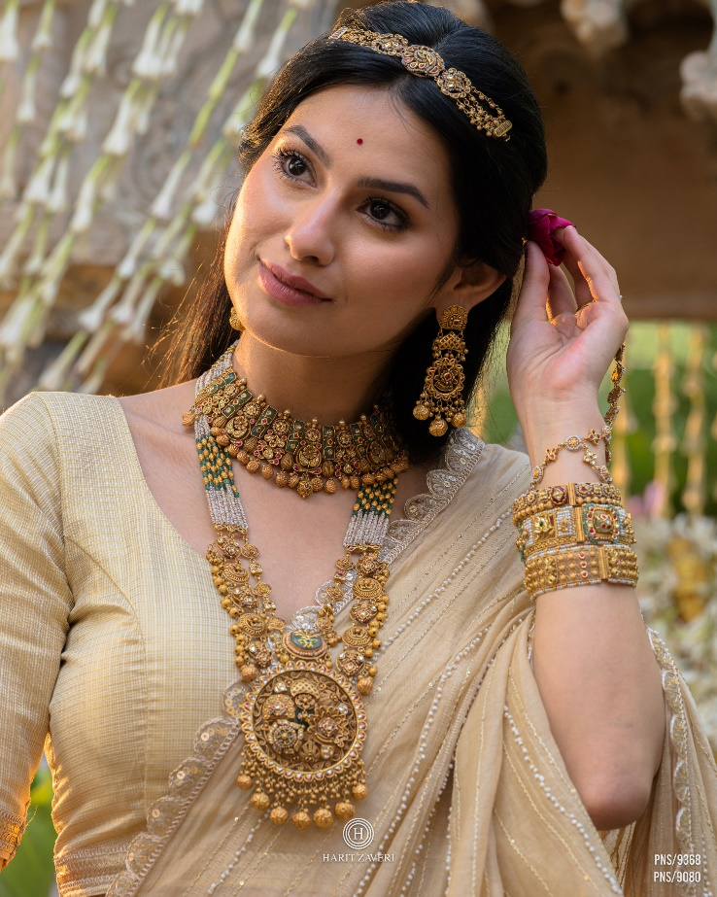
STRATEGIC OVERVIEW

Slide 19

Strengths
Complete control over design aesthetics with scalable capabilities and continuous innovation aligned to evolving trends
Brand built on the core values
of trust, transparency and innovation
Serving diverse client base across India in Wholesale segment,
including leading national
and regional retailers
Established systems and procedures to mitigate risk
Organised manufacturing
setup under one roof
Integrated setup providing cost efficiency, quality control and faster turnaround, strengthening margins across business segments

Slide 20




Key Differentiating Factors
Preference of national retailers
Gauge industry trends better
Insights into purchasing
behaviour and understanding
new trends in various zones
across India (we work in
72 cities)
Detailed market research,
sales analysis and feedback
Capability to handle large scale orders and deliver consistency in quality and design
Option to customise and produce their own unique product lines using our
in-house design team
Efficiencies due to integrated set-up
Efficiency, control, supply assurance and large-scale supplies
Control right from raw material procurement, design, manufacturing, marketing to sales
Better management oversight, security of precious metal due to reduced movement and controlling the manufacturing process loss
Maintaining uniqueness and secrecy of designs
Specially commissioned
designs are not used/ provided in/to our showroom/ other retailers
Ethical business practices promotes transparency, fairness and accountability

Slide 21
Technology Adoption Across Operations
Implementation
of SAP (S/4HANA)
SoP-Driven
Work Culture
Advanced Manufacturing Technology
Robust ERP system for strong internal controls and streamlined operations.
Standardisation of processes to ensure consistent and effective internal control.
Adoption of latest machinery and equipment such as casting and laser tools to enhance production efficiency and precision.

Slide 22
Growth Drivers
.
.
.
.
Manufacturing Scalability and Utilization Improvements
Asset-Light Growth via Retailer-Supplied Gold Model
Retail Scale-Up through Harit Zaveri Jewellers
Shift from Unorganized to Organized Jewellery Retail

Slide 23

Future Growth Strategies
Expanding
Market Footprint
Targeting expansion into the retail segment with 7 new showrooms across Gujarat over the next two Financial Years.
Expanding
Manufacturing
Capacity
Targeting maximum utilisation of existing manufacturing capacity by FY26
Developing the current capacity for variety of product mix for captive consumption as well.

Slide 24
Deepening Presence in Gujarat
Rationale for Expansion in Major Hub Cities of Gujarat:
Gujarat’s high per capita income, strong entrepreneurial culture, and deep global trade linkages create a structurally strong market for jewellery consumption.
The state’s ~8% contribution to India’s GDP offers both scale and a high concentration of premium customers.
This combination supports robust demand across both value and luxury segments.
The company is leveraging this advantage by deepening its presence in Gujarat as a strategic base before expanding nationally.
Sr. No. | Cities of Gujarat (Expansion Plan till March’27) | Type of Showroom | Owned/ Leased
1 | Surat | Flagship (Large Size) | Partly Owned Partly Lease
2 | Rajkot | Flagship (Large Size) | Lease
3 | Gandhinagar | Mid-Size | Lease
4 | Maninagar (East Ahmedabad) | Mid-Size | Lease

Slide 25

Q1FY27
FINANCIAL OVERVIEW

Slide 26
Financial Highlights
Q1FY27 Financial Performance
Revenue from Operations
EBITDA
EBITDA Margins
INR 1208 Mn
INR 180 Mn
14.9%
PAT
PAT Margins
Diluted EPS
INR 91 Mn
7.5%
INR 2.27
Revenue Performance:
Revenue increased by ~60% year-on-year, driven by robust customer demand, higher jewellery sales, and strengthening brand recall.

Slide 27
Segmental Performance

Slide 28

SALES VOLUME GRAPH (In Kgs)
Sales in Kgs
Period | Retail | Wholesale | Jobwork | Total
Q1FY27 | 49.57 | 30.63 | 95.27 | 175.47
Q4FY26 | 77.02 | 45.13 | 98.95 | 221.10
Q1 FY26 | 45.50 | 29.12 | 87.71 | 162.33

Slide 29
Operational Highlights
Delivered a healthy quarterly performance, with revenue growth in line with the guidance shared in the previous quarter, driven by robust customer demand, higher jewellery sales, and strengthening brand recall.
Participated in 5 jewellery exhibitions/trade shows during Q1 FY27, in Saurashtra region, North Gujarat, Ahmedabad etc. These exhibitions enabled the Company to showcase its latest collections, strengthen relationships with trade partners, and expand its customer reach.
Launched multiple successful digital marketing campaigns showcasing both occasion and daily collections:
  Occasional Wear: “Akshay Tritiya”, “Aangan”, “Godh Bharai”, “Mothers Day”, “Polki Shoot” showcasing our Antique wear, fusion, shringar related designs
  Similar to Occasional Wear, the Company strengthened the positioning of its lightweight and elegantly designed Daily Wear collection, 18K Rose Gold Collections through targeted digital branding campaigns such as “Home Coming”, “Samaiyu” “Rose”, “Vintage” across its social media platforms.
Retail Showroom Expansion
Retail expansion remains on track, with flagship showrooms in Surat (by Q2) and Rajkot (by early Q3), alongside mid-sized stores in Maninagar (Ahmedabad East) and Gandhinagar, aimed at strengthening geographic presence and enhancing direct customer access across high-growth Gujarat markets.
Exhibitions & Trade Participation
Participated in 5 jewellery exhibitions/trade shows during Q1 FY27, in Saurashtra region, North Gujarat, Ahmedabad etc.
These exhibitions enabled the Company to showcase its latest collections, strengthen relationships with trade partners, and expand its customer reach.

Slide 30
Quarterly Consolidated Income Statement
PARTICULARS (INR Mn) | Q1-FY27 | Q1-FY26 | Y-o-Y | Q4-FY26 | Q-o-Q
Operational Revenue | 1,208 | 756 | 59.8% | 1,895 | (36.3)%
Total Expenses | 1,029 | 626 | 64.4% | 1,683 | (38.9)%
EBITDA | 179 | 130 | 37.7% | 212 | (15.6)%
EBITDA Margins (%) | 14.82% | 17.20% | (238) Bps | 11.19% | 361 Bps
Other Income | 1 | 0.4 | 150.0% | 3 | (66.7)%
Depreciation | 16 | 8 | 100.0% | 14 | 14.3%
Finance Cost | 42 | 26 | 61.5% | 40 | 5.0%
PBT | 122 | 96 | 27.1% | 161 | (24.2)%
Tax | 31 | 25 | 24.0% | 44 | (29.5)%
PAT | 91 | 71 | 28.2% | 117 | (22.2)%
PAT Margins (%) | 7.53% | 9.39% | (190) Bps | 6.17% | 133 Bps
Other Comprehensive Income | - | - | - | (1) | -
Total Comprehensive Income | 91 | 71 | - | 116 | -
Basic/Diluted EPS (INR) | 2.27 | 1.78 | - | 2.92 | -

Slide 31
Annual Consolidated Income Statement
PARTICULARS (INR Mn) | FY26 | FY25 | Y-o-Y
Operational Revenue | 6,365 | 5,301 | 20.1%
Total Expenses | 5,446 | 4,659 | 16.9%
EBITDA | 919 | 642 | 43.1%
EBITDA Margins (%) | 14.44% | 12.11% | 233 Bps
Other Income | 4 | 6 | (33.3%)
Depreciation | 43 | 28 | 53.6%
Finance Cost | 141 | 95 | 48.4%
PBT | 739 | 525 | 40.8%
Tax | 191 | 137 | 39.4%
PAT | 548 | 388 | 41.2%
PAT Margins (%) | 8.61% | 7.32% | 129 Bps
Other Comprehensive Income | - | 1 | NA
Total Comprehensive Income | 548 | 389 | 40.9%
Basic/Diluted EPS (INR) | 13.70 | 9.70 | 41.2%

Slide 32
Historical Consolidated Income Statement
PARTICULARS (INR Mn) | FY23 | FY24 | FY25 | FY26
Operational Revenue | 2,879 | 3,274 | 5,301 | 6,365
Total Expenses | 2,501 | 2,892 | 4,659 | 5,446
EBITDA | 378 | 382 | 642 | 919
EBITDA Margins (%) | 13.13% | 11.67% | 12.11% | 14.44%
Other Income | 17 | 4 | 6 | 4
Depreciation | 14 | 14 | 28 | 43
Finance Cost | 83 | 76 | 95 | 141
PBT | 298 | 296 | 525 | 739
Tax | 75 | 80 | 137 | 191
PAT | 223 | 216 | 388 | 548
PAT Margins (%) | 7.75% | 6.60% | 7.32% | 8.61%
Other Comprehensive Income | 1 | - | (1) | -
Total Comprehensive Income | 224 | 216 | 387 | 548
Basic/Diluted EPS (INR) | 7.44 | 6.61 | 9.70 | 13.70

Slide 33
Historical Consolidated Balance Sheet
PARTICULARS (INR Mn) | FY24 | FY25 | FY26
Non-Current Assets
a) Property, plant and equipment | 263 | 269 | 337
b) Capital work-in-progress | - | 25 | 247
c) Rights to use assets | 3 | 37 | 273
d) Intangible Assets | 1 | 22 | 12
e) Intangible Assets under development | 21 | - | 3
f) Financial assets:
i) Loans | - | - | -
ii) Other Financial Assets | 1 | 2 | 6
g) Other non–current assets | 1 | 1 | 14
Total Non-Current Assets | 290 | 356 | 892
Current Assets
Inventories | 2,242 | 2,923 | 3,357
Financial assets:
i) Trade receivables | 126 | 173 | 558
ii) Cash and Cash Equivalents | 127 | 8 | 11
iii) Other bank balances | 18 | 19 | 20
iv) Loans | 1 | 1 | 1
v) Other Financial Assets | 11 | 25 | 5
Current Tax Assets (Net) | 4 | - | -
Other Current Assets | 23 | 15 | 16
Total Current Assets | 2,552 | 3,164 | 3,968
GRAND TOTAL - ASSETS | 2,842 | 3,520 | 4,860
PARTICULARS (INR Mn) | FY24 | FY25 | FY26
Equity
a) Equity Share Capital | 400 | 400 | 400
b) Other Equity | 1,675 | 2,050 | 2,598
Total Equity | 2,075 | 2,450 | 2,998
Non-Current Liabilities
Financial Liabilities
i) Borrowings | 200 | 7 | 225
ii) Lease Liabilities | 3 | 36 | 285
Provisions | 5 | 8 | 10
Deferred Tax Liability ( Net ) | 6 | 15 | 14
Total Non-Current Liabilities | 214 | 66 | 534
Current Liabilities
Financial Liabilities
i) Borrowings | 492 | 861 | 1,184
ii) Lease Liabilities | - | 4 | 3
iii) Trade Payables | 24 | 78 | 63
iv) Other Financial Liabilities | 10 | 15 | 13
Current tax liabilities (Net) | - | 4 | 3
Other Current Liabilities | 27 | 42 | 61
Provisions | - | - | 1
Total Current Liabilities | 553 | 1,004 | 1,328
Total Liabilities | 767 | 1,070 | 1,862
GRAND TOTAL - EQUITIES & LIABILITIES | 2,842 | 3,520 | 4860

Slide 34
Financial Performance

Slide 35
Capital Market Data
Indexed to 100
Price Data (30th June, 2026) | INR
Face Value | 10.0
Market Price | 137.85
52 Week H/L | 166.45 / 101.30
Market Cap (INR Mn) | 5,514.0
Equity Shares Outstanding (Mn) | 40.0
1 Year Avg Trading Volume (‘000) | 132.7

Slide 36


Disclaimer
No representation or warranty, express or implied, is made as to, and no reliance should be placed on, the fairness, accuracy, completeness or correctness of the information or opinions
contained in this presentation. Such information and opinions are in all events not current after the date of this presentation. Certain statements made in this presentation may not be based
on historical information or facts and may be "forward looking statements" based on the currently held beliefs and assumptions of the management RBZ Jewellers Limited (“Company” or
“RBZ Jewellers Ltd.”), which are expressed in good faith and in their opinion reasonable, including those relating to the Company’s general business plans and strategy, its future financial
condition and growth prospects and future developments in its industry and its competitive and regulatory environment.
Forward-looking statements involve known and unknown risks, uncertainties and other factors, which may cause the actual results, financial condition, performance or achievements of the
Company or industry results to differ materially from the results, financial condition, performance or achievements expressed or implied by such forward-looking statements, including future
changes or developments in the Company’s business, its competitive environment and political, economic, legal and social conditions. Further, past performance is not necessarily indicative of
future results. Given these risks, uncertainties and other factors, viewers of this presentation are cautioned not to place undue reliance on these forward-looking statements. The Company
disclaims any obligation to update these forward-looking statements to reflect future events or developments.
This presentation is for general information purposes only, without regard to any specific objectives, financial situations or informational needs of any particular person. This presentation does
not constitute an offer or invitation to purchase or subscribe for any securities in any jurisdiction, including the United States. No part of it should form the basis of or be relied upon in
connection with any investment decision or any contract or commitment to purchase or subscribe for any securities. None of our securities may be offered or sold in the United States, without
registration under the U.S. Securities Act of 1933, as amended, or pursuant to an exemption from registration there from.
This presentation is confidential and may not be copied or disseminated, in whole or in part, and in any manner.
For further details, please feel free to contact our Investor Relations Representatives
Ernst & Young LLP
Kanav Khanna | Rhea Dharia
Email: kanav.khanna@in.ey.com | Rhea.Dharia@in.ey.com
RBZ Jewellers Limited
Ms. Heli Garala
Company Secretary & Compliance Officer
Email: investor@rbzjewellers.com

Slide 37
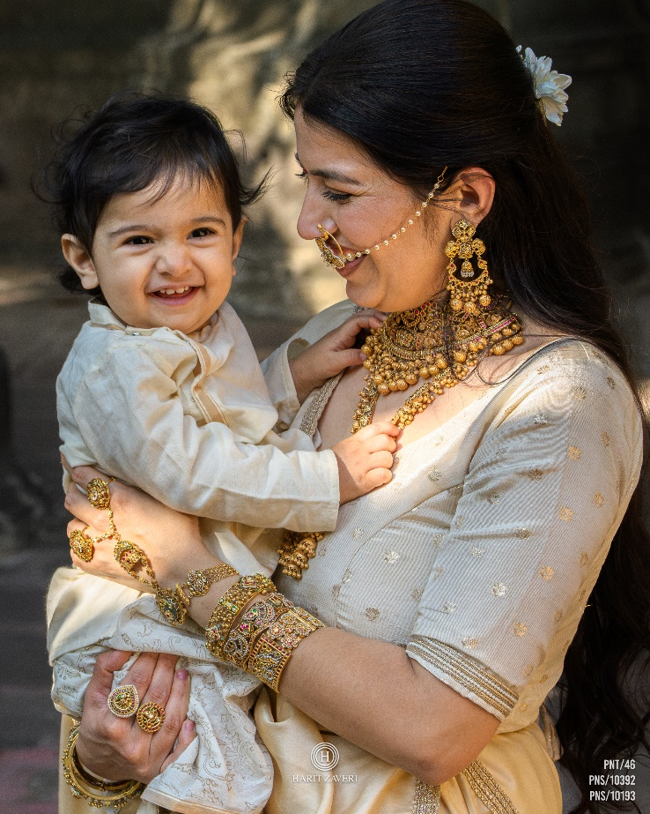
THANK YOU

